Slide 1


Variables
Chris Piech
CS106A, Stanford University

Slide 2
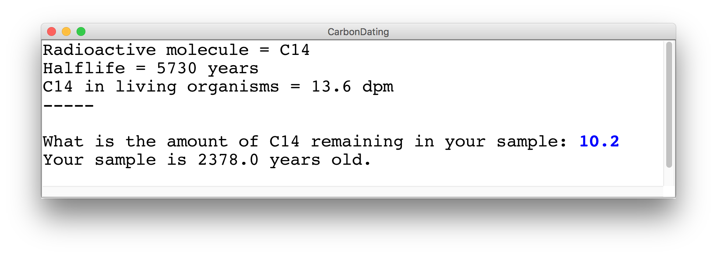
Challenge Carbon Dating
Write a program that can turn a measurement of C14 into an estimate of age.

Slide 3
Review: Decomposition
Each method solves one ”problem”
Methods should have good names
Comment each of your methods
Length of methods should be < 15 lines
Methods should ideally be generalizable
Notes:
He looks like an old machintosh machine.
Hes got legs… one sticks out the back. That’s just the way it is.

Slide 4


See You Later!
I will miss you.
Enjoy Java!
See you on the midterm .
Notes:
He looks like an old machintosh machine.
Hes got legs… one sticks out the back. That’s just the way it is.

Slide 5

Java

Slide 6


Today’s Goal
What are variables and how do I use them?
What are graphical objects and how do I use them?

Slide 7

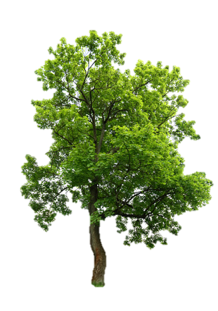
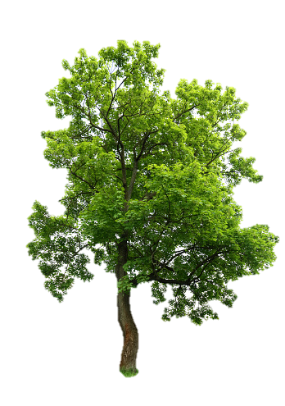
Today’s Route
You are here
Simple Java
Challenge
Graphics
Variables
Types of Programs
The River of Java

Slide 8
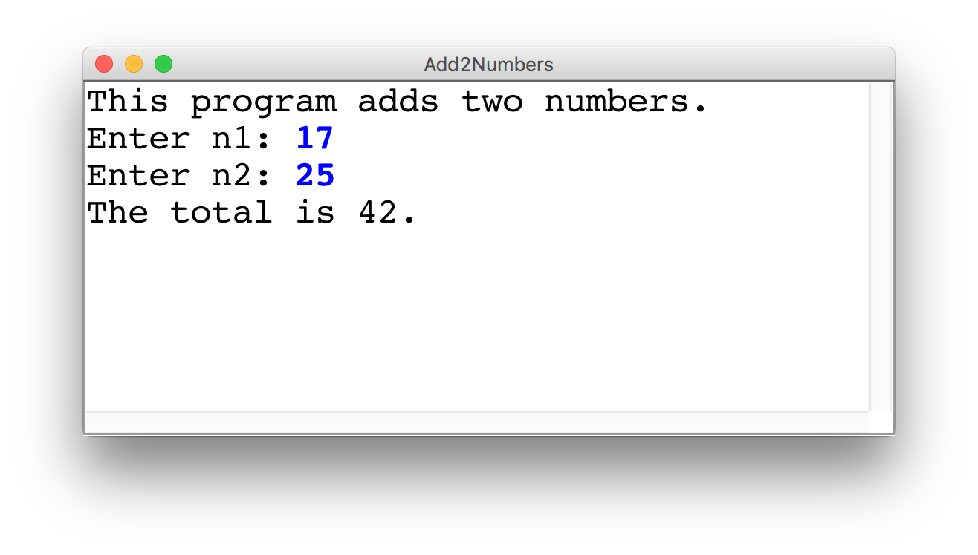
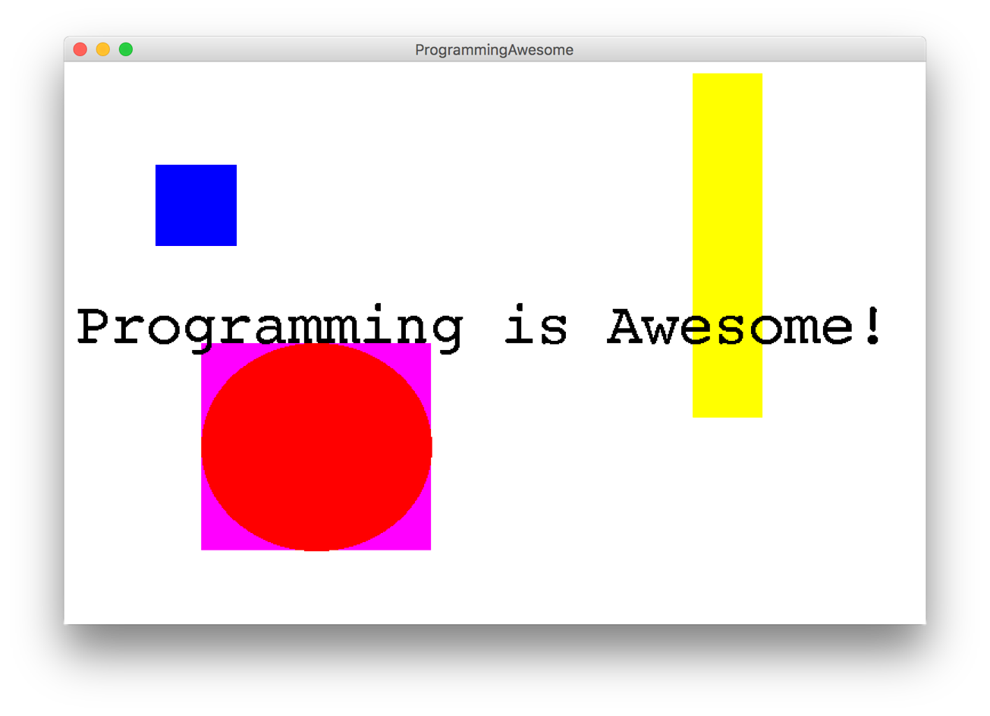
Two Example Programs

Slide 9
Types of Programs
Program
Karel Program
Console Program
Graphics Program
SuperKarel Program

Slide 10

First Console Program: Hello World
import acm.program.*;
public class HelloProgram extends ConsoleProgram {
public void run() {
println("hello, world");
}
}
HelloConsole
hello, world

Slide 11
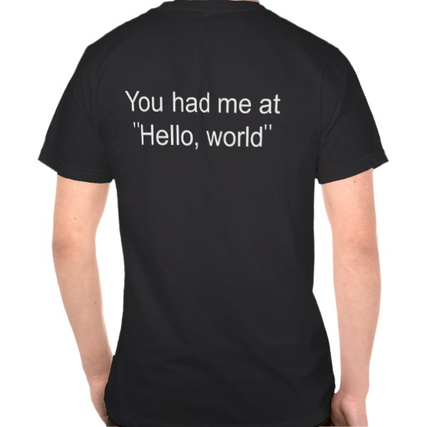
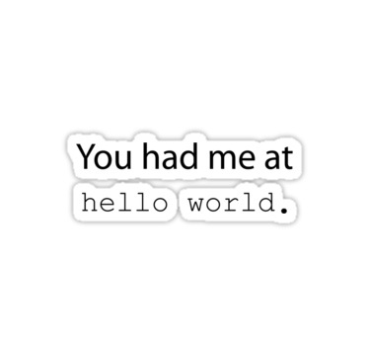
In Pop Culture

Slide 12
Add2Integers
class Add2Integers extends ConsoleProgram {
public void run() {
println("This program adds two numbers.");
int n1 = readInt("Enter n1: ");
int n2 = readInt("Enter n2: ");
int total = n1 + n2;
println("The total is " + total + ".");
}
}
n1
n1
n2
n2
total
total
17
17
25
25
42
42
Add2Integers
This program adds two numbers.
Enter n1:
17
Enter n2:
25
The total is 42.

Slide 13
Today’s Route
You are here
Simple Java
Challenge
Graphics
Variables
Types of Programs
The River of Java

Slide 14
Today’s Route
Simple Java
Challenge
Graphics
Variables
Types of Programs
The River of Java

Slide 15
Programs are control flow and variables

Slide 16
What is a variable?

Slide 17
[suspense]

Slide 18
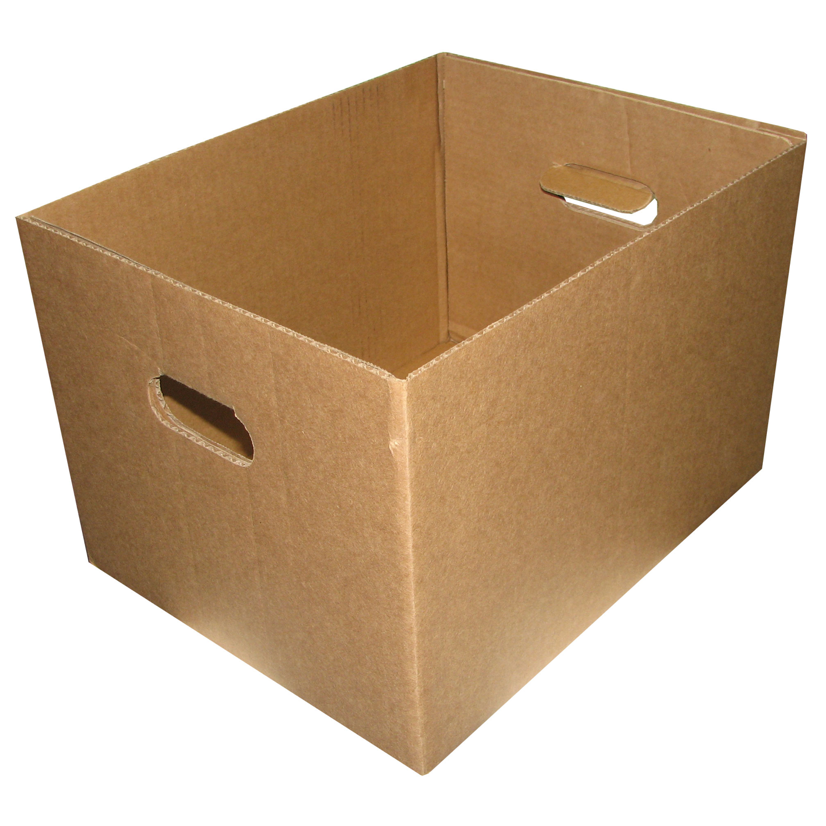
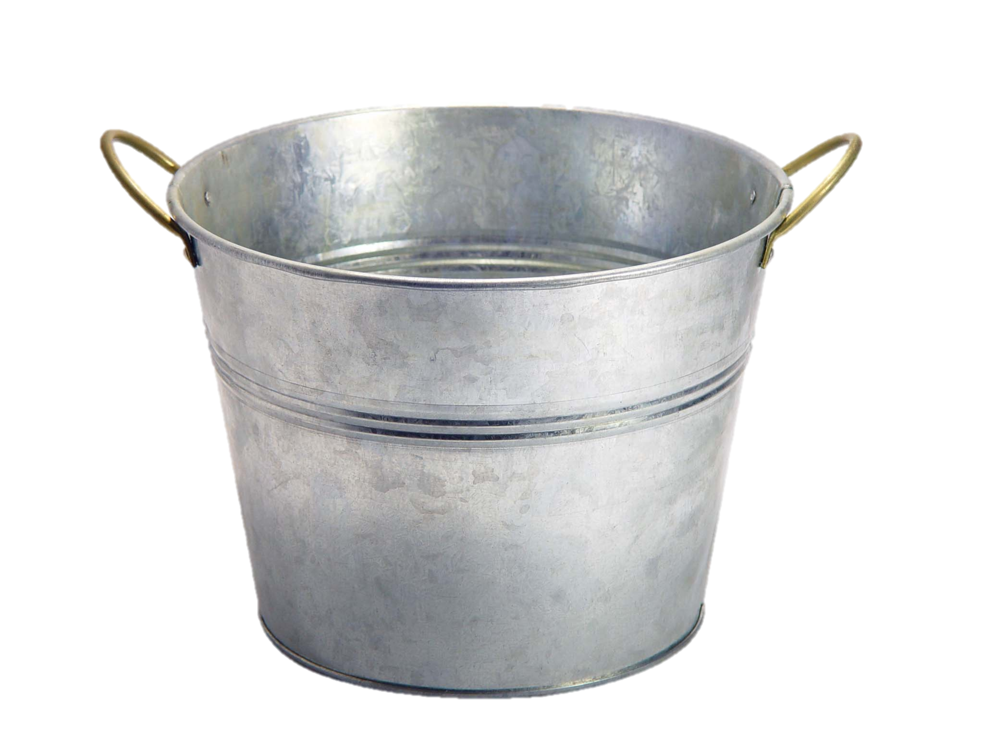
Variables are Like Boxes

Slide 19

Teeny Tiny Boxes
My computer has space for about 2 billion boxes

Slide 20
Three Properties
name
type
total
42
(contains an int)
value
Notes:
Type name = value

Slide 21
Types
// integer values
int num = 5;
// real values
double fraction = 0.2;
// letters
char letter = ‘c’;
// true or false
boolean isLove = true;
* Why is it called a double?

Slide 22
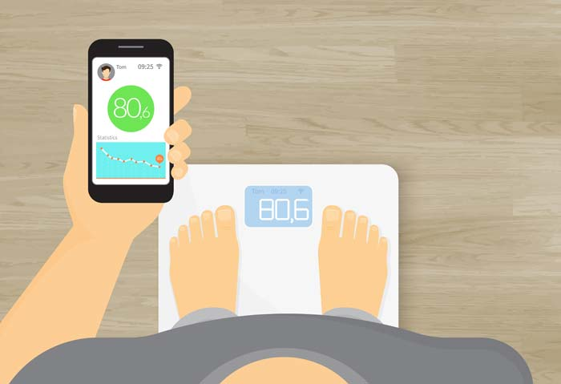
Double: How Much Do I Weigh?
* Answers could be real valued numbers

Slide 23
Int: How Many Children Do I Have?
* It is weird to say something like 1.7

Slide 24
Assignment

Slide 25
Add2Integers
class Add2Integers extends ConsoleProgram {
public void run() {
println("This program adds two numbers.");
int n1 = readInt("Enter n1: ");
int n2 = readInt("Enter n2: ");
int total = n1 + n2;
println("The total is " + total + ".");
}
}
n1
n1
n2
n2
total
total
17
17
25
25
42
42
Add2Integers
This program adds two numbers.
Enter n1:
17
Enter n2:
25
The total is 42.

Slide 26
User Input
int a = readInt(“msg”);
double b = readDouble(“msg”);

Slide 27
Binary Operators
+
Addition
*
Multiplication
–
Subtraction
/
Division
%
Remainder
See you another day, tio.

Slide 28
What do you think this does?
println(1 / 2);

Slide 29
AHHHHHHH!!!!!!
println(1 / 2);

Slide 30
Resulting Type
int + int results in an int
double + double results in a double
int + double results in a double
* The general rule is: operations always return the most expressive type

Slide 31
Operation Examples

Slide 32
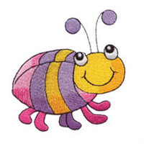
Pitfalls of Integer Division
Convert 100˚ Celsius temperature to its Fahrenheit equivalent:
double c = 100;
double f = 9 / 5 * c + 32;
The computation consists of evaluating the following expression:
9 / 5 * c + 32
The problem arises from the fact that both 9 and 5 are of type int, which means that the result is also an int.
132
100
1
9 / 5 * c + 32

Slide 33
Pitfalls of Integer Division
You can fix this problem by converting the fraction to a double, either by inserting decimal points or by using a type cast:
double c = 100;
double f = 9.0 / 5 * c + 32;
The computation now looks like this:
212.0
180.0
1.8
9.0
/ 5 * c + 32

Slide 34
Today’s Route
Simple Java
Challenge
Graphics
Variables
Types of Programs
The River of Java

Slide 35
Today’s Route
Simple Java
Challenge
Graphics
Variables
Types of Programs
The River of Java

Slide 36
Types of Programs
Program
Karel Program
Console Program
Graphics Program
SuperKarel Program

Slide 37
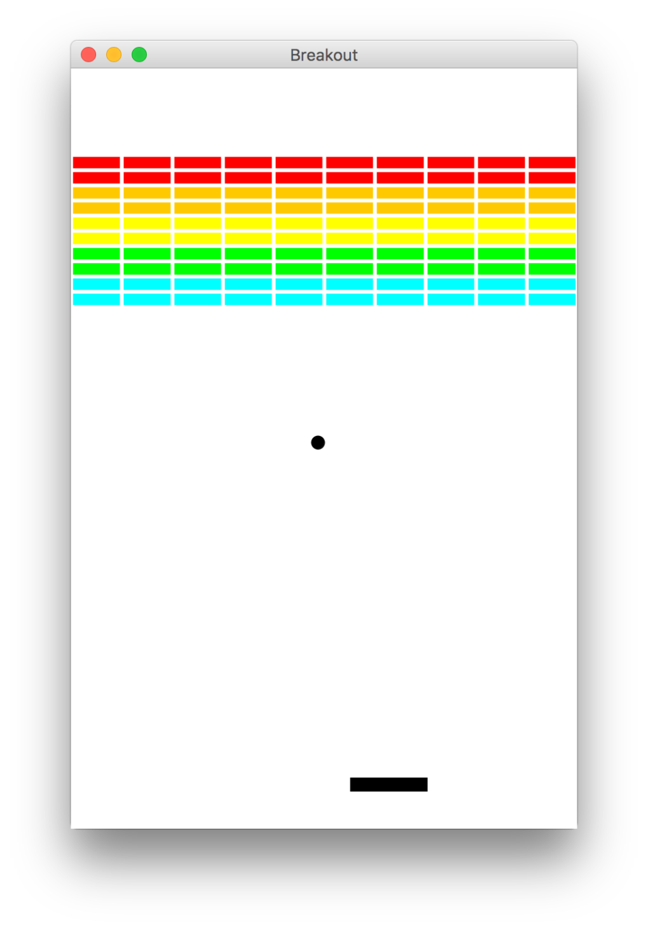
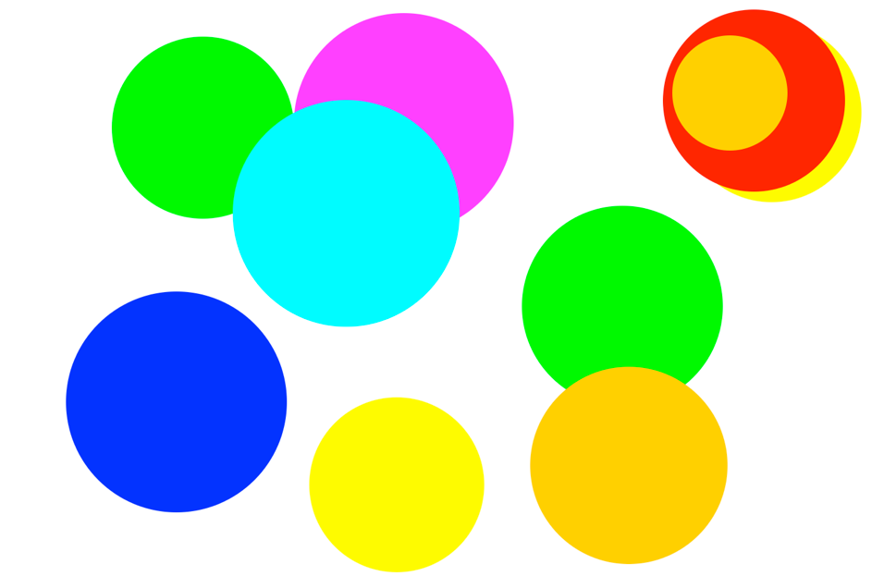
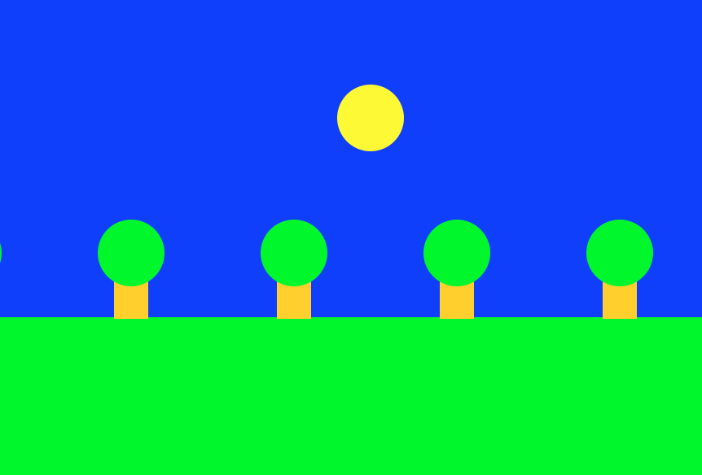
Graphics Programs

Slide 38
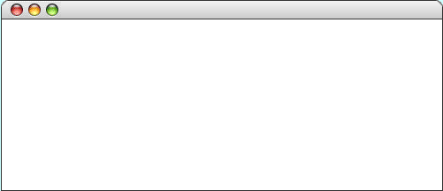
GRect
GRect is a variable type that stores a rectangle.
As an example, the following run method displays a blue square
public void run() {
Grect rect = new GRect(200, 200);
rect.setFilled(true);
rect.setColor(Color.BLUE);
add(rect, 50, 50);
}
LargestOval

Slide 39
Graphics Coordinates
0,0
40,20
120,40
getHeight();
40,120
getWidth();

Slide 40
GOval
The GOval class represents an elliptical shape defined by the boundaries of its enclosing rectangle.
As an example, the following run method creates the largest oval that fits within the canvas:
public void run() {
GOval oval = new GOval(getWidth(), getHeight());
oval.setFilled(true);
oval.setColor(Color.GREEN);
add(oval, 0, 0);
}
LargestOval

Slide 41
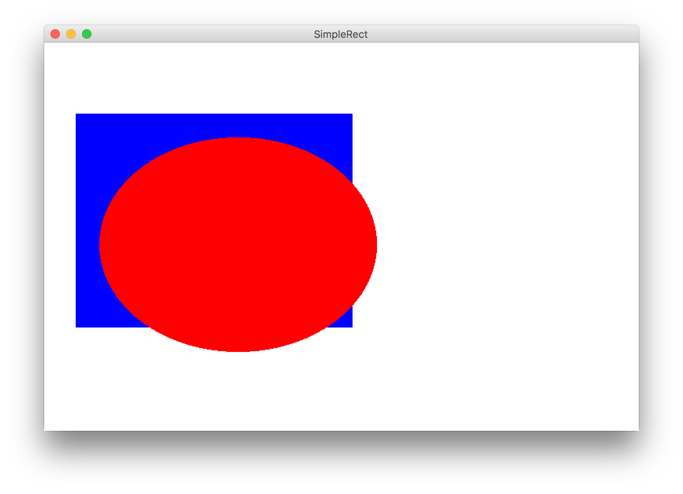
Learn By Example

Slide 42
Graphics Variable Types
GObject
GLabel
GRect
GOval
others…
GRect myRect = new GRect(350, 270);

Slide 43
Primitives vs Classes
Primitive Variable Types
Class Variable Types
int
double
char
boolean
GRect
GOval
GLine
…
Class variables:
Have upper camel case types
You can call methods on them
Are constructed using new
Are stored in a special way

Slide 44
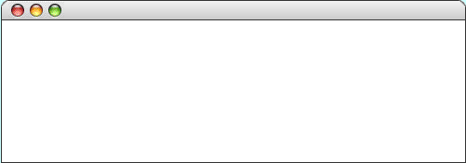
Graphics Trace
The following program illustrates sending a message to an object. Note that the label doesn’t appear until it is added to the canvas.
public class HelloProgram extends GraphicsProgram {
public void run() {
GLabel label = new GLabel("hello, world");
label.setFont("SansSerif-36");
label.setColor(Color.RED);
add(label, 100, 75);
}
}
label
hello, world
hello, world
hello, world
HelloProgram
hello, world
Graphic courtesy of Eric Roberts
skip simulation

Slide 45
Label Location
Origin is upper left
Everything measured in pixels (dots on the screen)
x coordinates increase to the right
y coordinates increase going down
GLabel coordinates are baseline of first character
(0, 0)
HelloProgram
hello, world
(100, 75)
Graphic courtesy of Eric Roberts

Slide 46
Operations on GRect
object.setColor(color)
Sets the color of the object to the specified color constant.
The standard color names are defined in the java.awt package:
Color.BLACK
Color.DARK_GRAY
Color.GRAY
Color.LIGHT_GRAY
Color.WHITE
Color.RED
Color.YELLOW
Color.GREEN
Color.CYAN
Color.BLUE
Color.MAGENTA
Color.ORANGE
Color.PINK

Slide 47
Operations on GRect
object.setColor(color)
Sets the color of the object to the specified color constant.
object.setLocation(x, y)
Changes the location of the object to the point (x, y).
object.move(dx, dy)
Moves the object on the screen by adding dx and dy to its current coordinates.
object.setFilled( fill)
If fill is true, fills in the interior of the object; if false, shows only the outline.
object.setFillColor( color)
Sets the color used to fill the interior, which can be different from the border.
object.getWidth()
Returns the width of the rectangle.
object.getHeight()
Returns the height of the rectangle.

Slide 48
Operations on GOval
object.setColor(color)
Sets the color of the object to the specified color constant.
object.setLocation(x, y)
Changes the location of the object to the point (x, y).
object.move(dx, dy)
Moves the object on the screen by adding dx and dy to its current coordinates.
object.setFilled( fill)
If fill is true, fills in the interior of the object; if false, shows only the outline.
object.setFillColor( color)
Sets the color used to fill the interior, which can be different from the border.
object.getWidth()
Returns the width of the rectangle.
object.getHeight()
Returns the height of the rectangle.

Slide 49
Operations on GLabel
Methods specific to the GLabel class
label.setFont( font)
Sets the font used to display the label as specified by the font string.
label.getAscent( )
Returns the height of the label above its baseline.
The font is typically specified as a string in the form
"family-style-size"
family is the name of a font family
style is either PLAIN, BOLD, ITALIC, or BOLDITALIC
size is an integer indicating the point size
Based on slides by Eric Roberts

Slide 50
Construction
new GRect( width, height)
Creates a rectangle with dimensions width and height.
new GOval(width, height)
Creates an oval that fits inside the rectangle with the same dimensions.
new GRect( x, y, width, height)
Creates a rectangle whose upper left corner is at (x, y) of the specified size.
new GOval( x, y, width, height)
Creates an oval that fits inside the rectangle with the same dimensions.
new GLabel( text)
Creates a label with the given text.
Based on slides by Eric Roberts

Slide 51

Another Example

Slide 52
Today’s Route
Simple Java
Challenge
Graphics
Variables
Types of Programs
The River of Java

Slide 53
Today’s Route
Simple Java
Challenge
Graphics
Variables
Types of Programs
The River of Java

Slide 54
Challenge Carbon Dating
Write a program that can turn a measurement of C14 into an estimate of age.

Slide 55
Example: Carbon Dating
C14 = 1.2 dpm
C14 = 13.6 dpm

Slide 56
Carbon Dating Equation
Amount of C14 in your sample
Amount of C14 in a living sample
Half life of C14
Age of the sample
½ because of half life convention
* Some of these values are constants
** Use the function: Math.log( num )

Slide 57
Today’s Route
Simple Java
Challenge
Graphics
Variables
Types of Programs
The River of Java

Slide 58
Today’s Goal
What are variables and how do I use them?
What are graphical objects and how do I use them?

Slide 59

The End?

